Slide 1

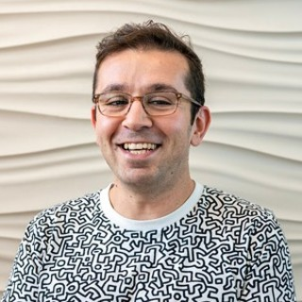
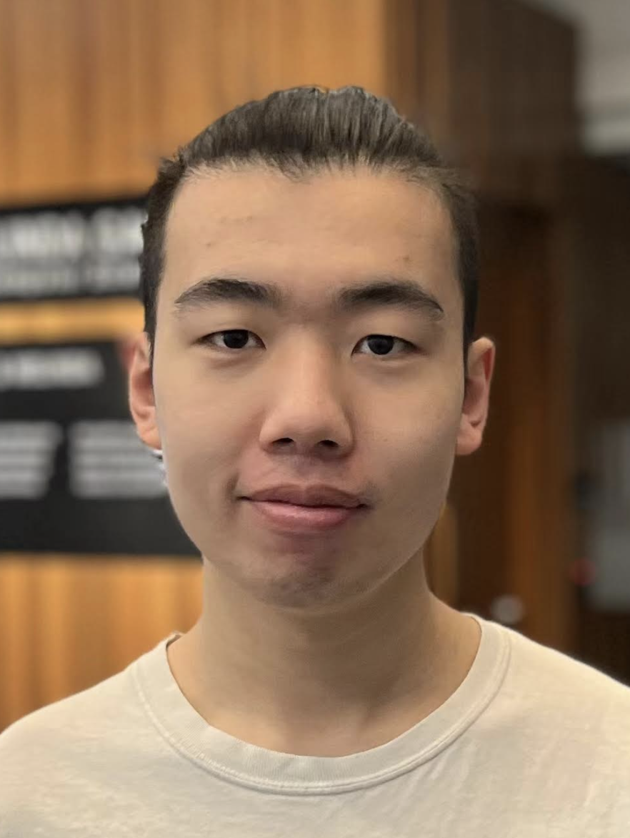
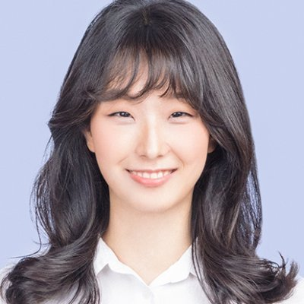




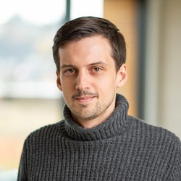
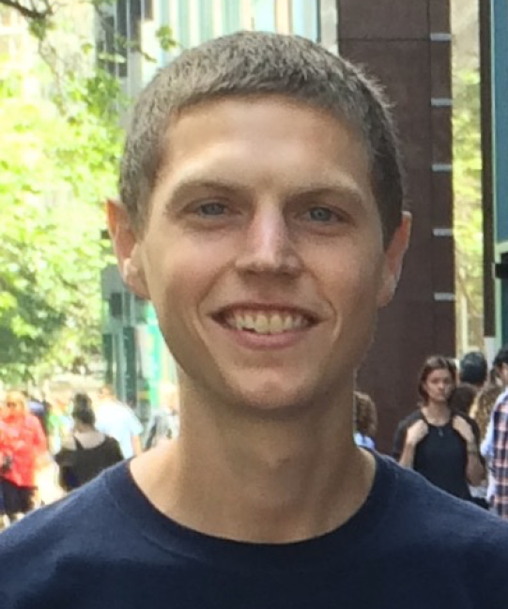

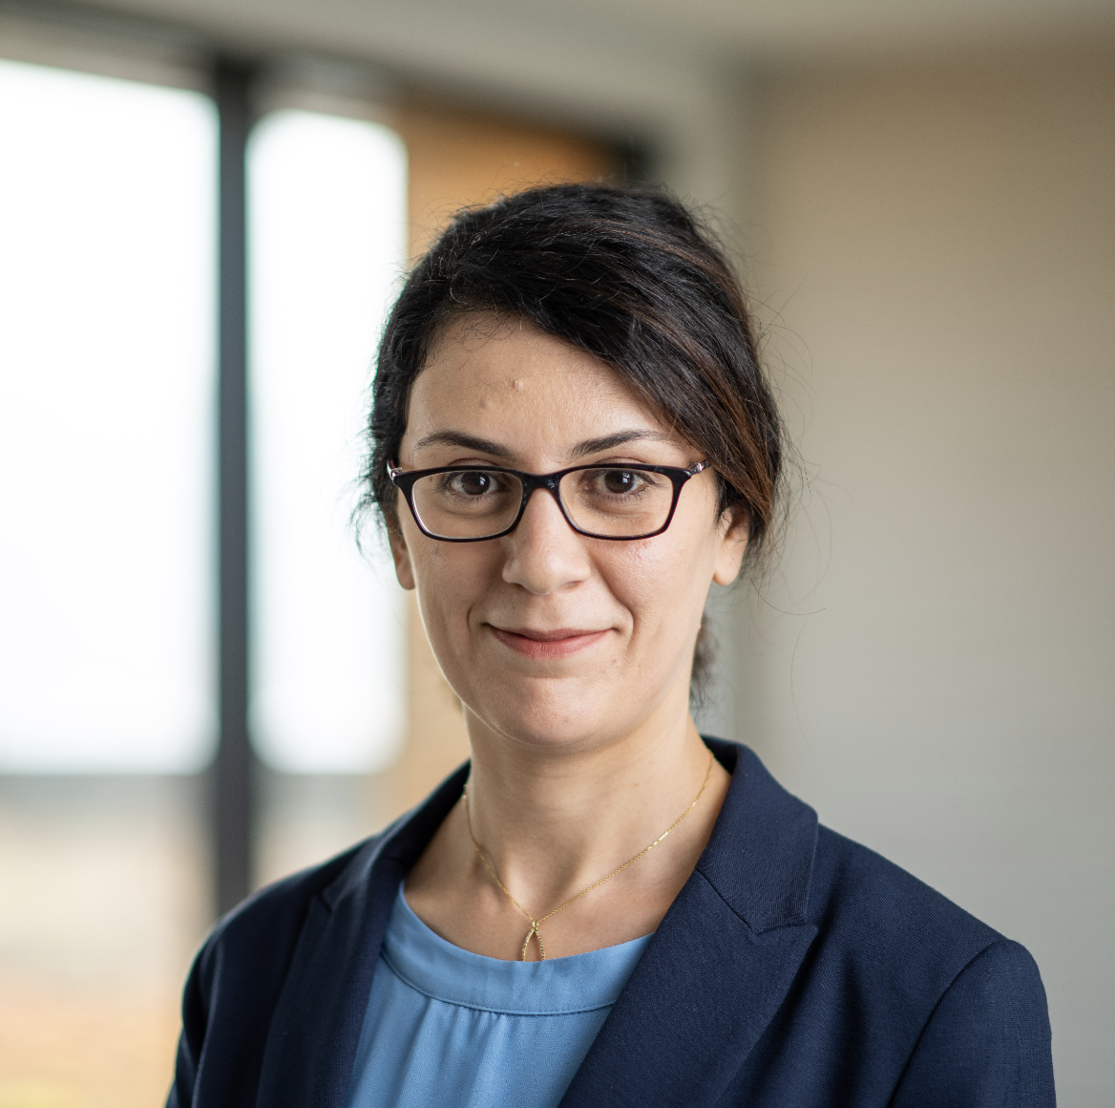
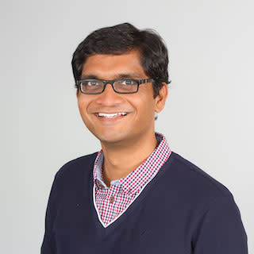
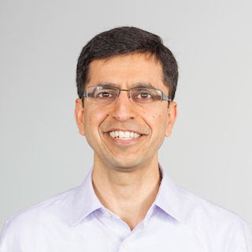

Prompt Waywardness: On Discretized Interpretation of Continuous Prompts
Daniel Khashabi Xinxi Lyu Sewon Min
Lianhui Qin Kyle Richardson Sean Welleck
Hannaneh Hajishirzi Tushar Khot Ashish Sabharwal Sameer Singh Yejin Choi
Notes:
Hi, I am Daniel Khashabi and I am going to present our work on …. 11 This is a joint endeavor with many wonderful colleagues at different institutions.

Slide 2
pre-trained
language models (LM)
LM
[Peters+ 2018 , Radford+ 2019, Brown+ 2020, …. ]
Notes:
As you all know, the rise of pre-trained language models has brought up a lot excitement about their emergent ability in responding to language commands.

Slide 3
LM
Language prompt
[Peters+ 2018 , Radford+ 2019, Brown+ 2020, …. ]
Notes:
We can feed language prompts to these models to solve well-defined tasks that we care about.

Slide 4

discrete (text) prompts: easy to interpret, but not easy to optimize
What is the sentiment of the following review? (positive or negative)
LM
Sentence: That was a great fantasy movie.
positive
Language prompt
[Peters+ 2018 , Radford+ 2019, Brown+ 2020, …. ]
Notes:
Just as a toy example, suppose I want to classify sentiment of a bunch of movie reviews. ...
We can prepend a language prompt (that defines our task) to an input (in this case, a movie review), to which the model may answer with "positive" or "negative".
A key nice attribute of discrete prompts is their ”interpretability”:
Since language is a convenient medium of communication, they enable average humans to interact with models and form expectations their internal behavior– which is nice!
The challenge here though is that, we don't have efficient algorithms for finding most effective discrete prompts.
And this is a key bottleneck, if you want to build tools that maximize your desired metric for whatever application you want to build.

Slide 5
discrete (text) prompts: easy to interpret, but not easy to optimize
What is the sentiment of the following review? (positive or negative)
LM
Sentence: That was a great fantasy movie.
positive
Notes:
In parallel, there is a line of work on …

Slide 6
discrete (text) prompts: easy to interpret, but not easy to optimize
What is the sentiment of the following review? (positive or negative)
LM
Sentence: That was a great fantasy movie.
positive
Something related to sentiment analysis? 🤔
continuous prompts:
unclear how to interpret, but easy to optimize
0.9 | 0.1 | -2.1 | 0.0
LM
Sentence: That was a great fantasy movie.
positive
[Li and Liang 2021; Lester+ 2021]
Notes:
... continuous prompts
Typically defined as a vector of real numbers prepended to the embedding of an input text to make the model generate a desired outcome.
For example, a continuous prompts that effectively solves the sentiment classification task.
Turns out that continuous prompts are complementary to their discrete counterparts:
We have algorithms for effectively optimizing them.
However, meaningful interpretation of continuous prompts as natural language is an open question problem.
(click) --- maybe this particular continuous prompt has something to do with sentiment analysis?? Unclear.
Motivated by this, we are interested in the research question of …
Motivated by the discrepancies between discrete and continuous prompts, we study focus continuous prompts and their interpretability.

Slide 7
Research question: are there any meaningful discrete (textual) interpretations to continuous prompts?
Opposite: how unfaithful can their interpretation be to what they do?
Something related to sentiment analysis? 🤔
0.9 | 0.1 | -2.1 | 0.0
LM
Sentence: That was a great fantasy movie.
positive
Notes:
…. the research question of: … that provide a faithful explanation of their behavior.
Since we don’t know how to address this question directly, we actually study its opposite: …

Slide 8
Research question: are there any meaningful discrete (textual) interpretations to continuous prompts?
any arbitrary text:
Opposite: how unfaithful can their interpretation be to what they do?
Flip the sentiment of the sentence
Proj(.)
0.9 | 0.1 | -2.1 | 0.0
LM
Sentence: That was a great fantasy movie.
positive
Notes:
What I mean by that is, we investigate whether there are any continuous prompts that perform a desired task while, at the same time, project to any given target text,
Such as the definition of a different task (“negating the sentiment of a given sentence.”).
Our findings in this work suggests that the opposite question is likely to be correct.
Which is what call …

Slide 9
Waywardness hypothesis (informal):
One can find “accurate” continuous prompts such that they can be “projected” to any arbitrary text.
any arbitrary text:
Opposite: how unfaithful can their interpretation be to what they do?
Flip the sentiment of the sentence
Proj(.)
0.9 | 0.1 | -2.1 | 0.0
LM
Sentence: That was a great fantasy movie.
positive
Notes:
the "waywardness" hypothesis:
which states that ….. (such as the definition of a different task or even an irrelevant statement.
This essentially suggests a disconnect between the outcome of continuous prompts and their discrete interpretations.

Slide 10
Waywardness hypothesis (informal):
One can find “accurate” continuous prompts such that they can be “projected” to any arbitrary text.
any arbitrary text:
Flip the sentiment of the sentence
Proj(.)
0.9 | 0.1 | -2.1 | 0.0
LM
Sentence: That was a great fantasy movie.
positive
Notes:
which states that ….. (such as the definition of a different task or even an irrelevant statement.
This essentially suggests a disconnect between the outcome of continuous prompts and their discrete interpretations.
This is really the key message here, if you want to remember one thing our work.
Next I am gonna show some empirical results for "waywardness" hypothesis.

Slide 11
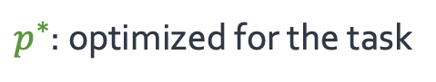
$p^{∗}$: optimized for the task
LM
Sentence: That was a great fantasy movie.
positive
Notes:
We do series of experiments where we compare performance of two prompts:
A prompt that are trained to solve a particular task (let's call it 𝑝∗)

Slide 12
definition of another task:
Write down the conclusion you can reach by combining the given Fact 1 and Fact 2.
$\tilde{p}$: optimized for the task + project to a given text
$p^{∗}$: optimized for the task
LM
Sentence: That was a great fantasy movie.
positive
Notes:
And another prompt (call it 𝑝 ̃) that are not only trained to solve a given task, but also forced to project to a text provided as input.
For example, … which is the definition of a different task.

Slide 13
nearest-neighbor mapping of continuous prompt onto the word embeddings
definition of another task:
Write down the conclusion you can reach by combining the given Fact 1 and Fact 2.
$\tilde{p}$: optimized for the task + project to a given text
random sentence from web:
int clamp(int val, int min_val) { return std::max(min_val, val);
}
$p^{∗}$: optimized for the task
LM
Sentence: That was a great fantasy movie.
positive
Notes:
Or a variety of random sentences we sampled from the web.
….
What do I mean by “projection”?
In our experiments we use nearest-neighbor projection of continuous prompt onto the word embeddings via dot product.
which is a commonly used in the field, for example, it is used in generative language models.

Slide 14

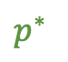

EXPECTATION
$\tilde{p}$: optimized for the task + project to a given text
$$\tilde{p}$$
$$Δ$$
$p^{∗}$: optimized for the task
$p^{∗}$
accuracy
LM
Sentence: That was a great fantasy movie.
positive
Notes:
Now, empirically we compare the performance of $\tilde{p}$ and $p^{∗}$ on the downstream task.
How do we expect these prompts to fair?
The intuition here is that, if continuous prompt has something inherent in it about the task they solve, by forcing them to project an irrelevant text, they should suffer in terms of their task accuracy.

Slide 15
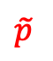

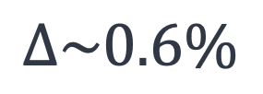
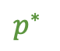

continuous prompts that
project to any given text
with tiny drop in task accuracy!
EXPECTATION
$$\tilde{p}$$
$$Δ$$
$p^{∗}$
accuracy
$\tilde{p}$: optimized for the task + project to a given text
REALITY
$$\tilde{p}$$
91.8
$$Δ\sim 0.6\%$$
$p^{∗}$: optimized for the task
$p^{∗}$
92.4
accuracy
≈
40 60 80 100
accuracy
LM
Sentence: That was a great fantasy movie.
positive
Notes:
In practice what we observe that, it is possible to find continuous prompts that project to a given text (≥ 94% token overlap with the given text) with tiny drop in task accuracy.

Slide 16
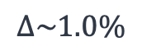
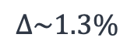
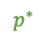
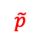
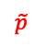
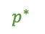
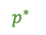
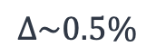
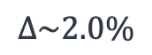
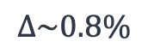
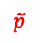

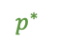
5 benchmarks
x
60 target prompts
accuracy
accuracy
accuracy
≈
70 80 90 100
40 60 80
≈
70 80 90 100
≈
$$\tilde{p}$$
87.3
$$\tilde{p}$$
49.3
$$\tilde{p}$$
91.9
$$Δ\sim 0.8\%$$
$$Δ\sim 1.0\%$$
$$Δ\sim 0.5\%$$
$p^{∗}$
88.1
$p^{∗}$
50.3
$p^{∗}$
92.4
topic classification (AGNews)
sentiment classification (SST-5)
sentiment classification (SST-2)
accuracy
accuracy
70 80 90 100
≈
70 80 90 100
≈
$$\tilde{p}$$
89.2
$$\tilde{p}$$
86.0
$$Δ\sim 1.3\%$$
$$Δ\sim 2.0\%$$
$p^{∗}$
90.5
$p^{∗}$
88.0
subjectivity classification (Subj)
question type classification (TREC)
Notes:
And not just for sentiment analyses; we repeat this across 5 different benchmarks and observe similar trends, …
Which is basically an empirical support for waywardness hypothesis.

Slide 17
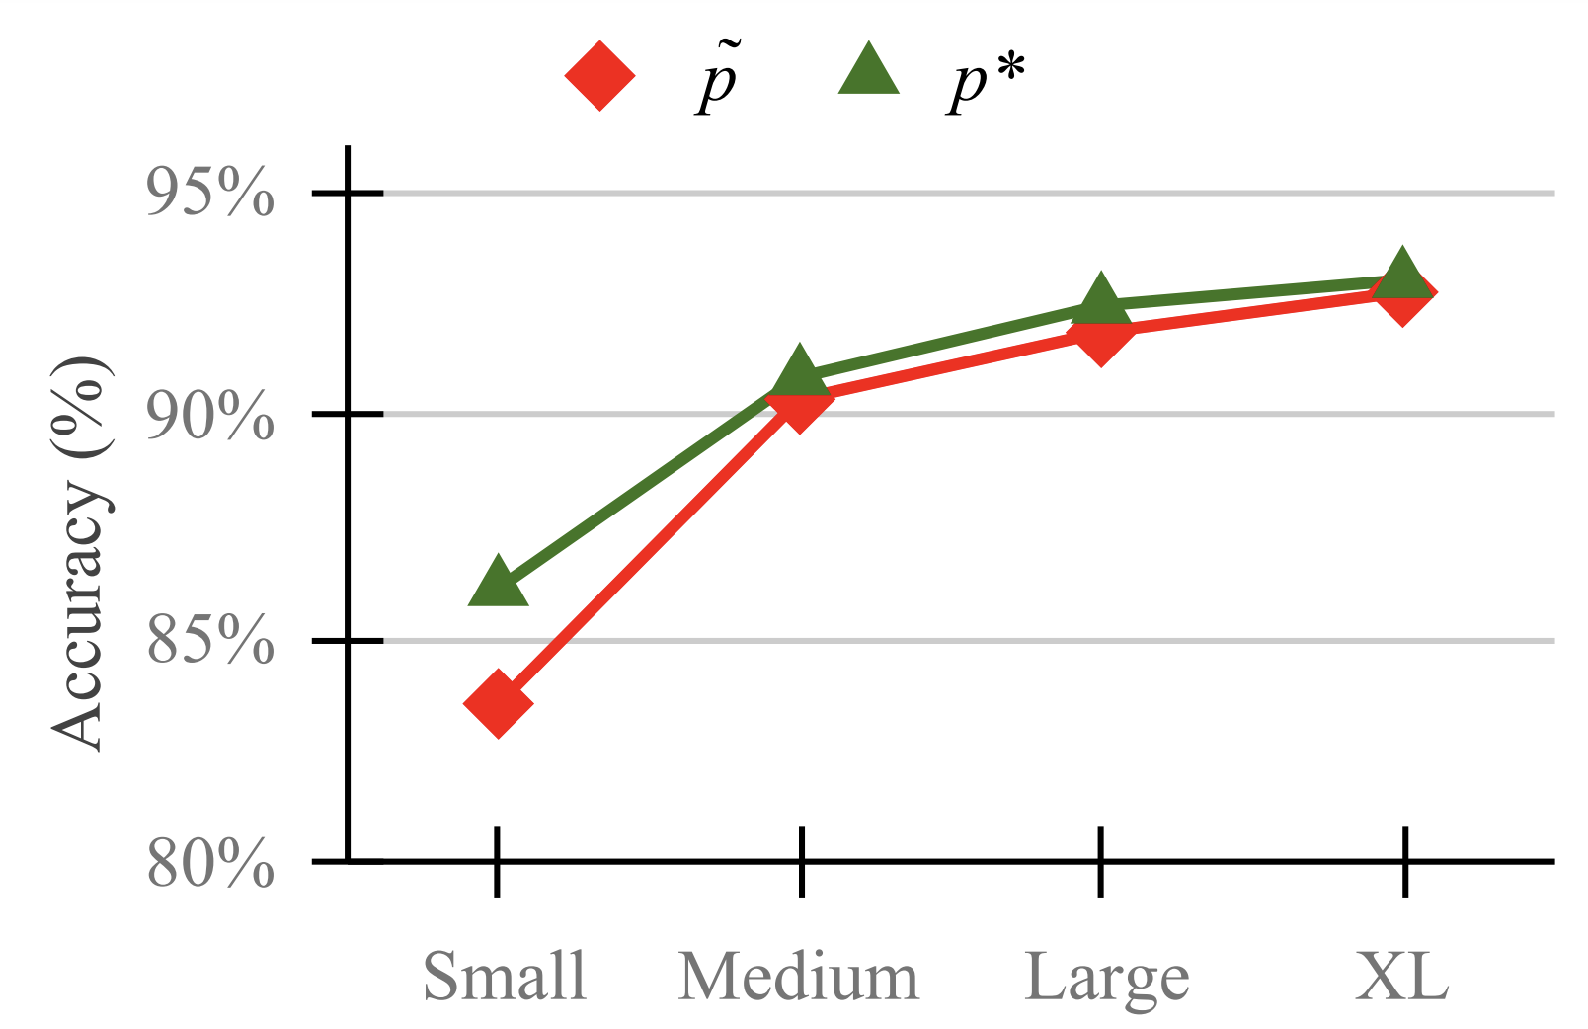
Continuous prompts on larger LMs show more “wayward” behavior!
Notes:
Moreover, accuracy gap between these two prompts decreases as models become larger.
In other words, …
[yet another pragmatic concern in using these large models.]
There are more experiments in the paper that I won’t get into. Instead, I will use the remainder of my time to share intuitions that enable “waywardness” and its implications.

Slide 18
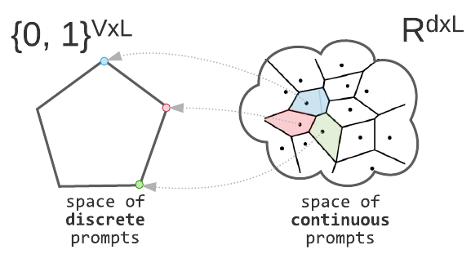
Making Sense of “Waywardness”
(1) The mapping between continuous and discrete space is not one-to-one.
Notes:
Now, let's try to make sense of "waywardness" (why is it happening?)
The first issue is that the mapping between continuous and discrete space is not one-to-one.
While each discrete prompt is mapped to exactly one continuous representation, the reverse is not true:
There are many continuous prompts that project back to a fixed discrete prompt
This statement is true for not just our choice of projection, but rather many well-defined projections, well-beyond the nearest neighbor projection that we tried empirically here.

Slide 19
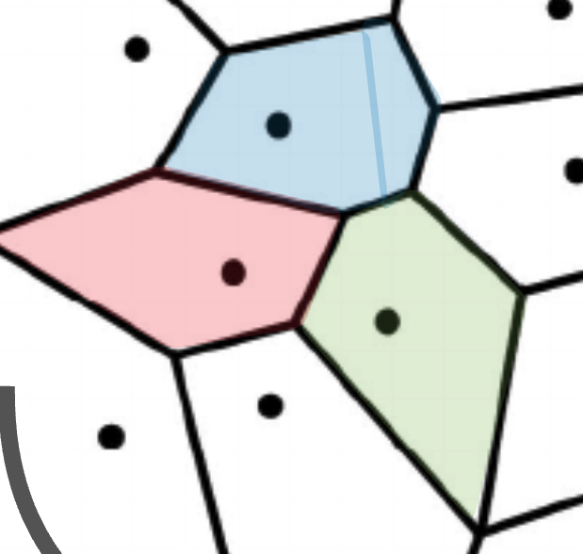

Making Sense of “Waywardness”
(1) The mapping between continuous and discrete space is not one-to-one.
It is true for many choices of Proj(.)
(2) Deep models give a lot of expressivity power to the earlier layers.
[Telgarsky 2016; Raghu+ 2017]
$$ε$$
Notes:
This indicate that there is a regions in continuous space that correspond to a fixed discrete representation.
The remaining question is, how is this region be so rich that it can solve a variety of tasks?
The answer to that the expressivity of large models with respect to their inputs which also includes continuous prompts.
It is the combination of these two intuitions (to our understanding) that give rise to “waywardness”.
Now, before I end, …

Slide 20
Implications of Waywardness
Notes:
Now, before I end, let me briefly enumerate ….

Slide 21
Implications of Waywardness
Faithful interpretation of continuous prompts is difficult.
Something related to sentiment analysis?
continuous prompts:
unclear how to interpret, but easy to optimize
0.9 | 0.1 | -2.1 | 0.0
LM
Sentence: That was a great fantasy movie.
positive
Notes:
…. several implications of “waywardness” hypothesis.
The immediate issue is concerning “continuous” prompts.
As I argued, faithful discrete interpretations of continuous prompts via common discrete projections are unlikely to be robust, based on current modeling paradigms.
Whether there is a better constructions of continuous prompts is an open question that the future work should address.

Slide 22

Implications of Waywardness
Faithful interpretation of continuous prompts is difficult.
Harms of [mis]interpreting continuous prompts.
continuous prompt
😇 benign projection
Proj(.)
Rank the candidates ignoring their race or gender.
LM
😈 malicious behavior
👩🏽‍🎓 < 👨🏽‍🎓 < 👨🏻‍🎓
Notes:
If we don’t have effective interpretations for prompts, there can be social risks,
In a future where model development is driven by fine-tuned prompts, these prompts would be used in high-stake applications and might that social biases affecting minorities in them.
Naïve efforts to interpret these may indicate benign statements, which do not reveal the true malicious nature of their behavior.
and be exploited to create a false sense of security and fairness.
The customers might even evaluate the prompt on a few instances but not notice this harmful behavior, e.g., when it effects a minority group not in the evaluation set.

Slide 23
Implications of Waywardness
Faithful interpretation of continuous prompts is difficult.
Harms of [mis]interpreting continuous prompts.
Difficulty of optimizing discrete prompts.
Sufficiency of task-independent initialization for continuous prompt tuning.
Notes:
There are other implications too, that I am not get into their details here in this presentation.
If you’re interested in learning about any of these, feel free to check out the paper or ping offline after the talk.

Slide 24
Summary
Waywardness hypothesis (informal):
One can find “accurate” continuous prompts such that they can be “projected” to any arbitrary text.
We provided empirical evidence and intuitions for this hypothesis.
Concluded with implications of this hypothesis.
We need algorithmic or architectural innovations for automatic discovery prompts that are faithful to what they solve.
Notes:
We started with … a surprising difficulty in interpreting continuous prompts.
We provided
And concluded
My hope is that, these observations motivate future algorithmic or architectural innovations toward effective prompts that are faithful to the task they solve

Slide 25
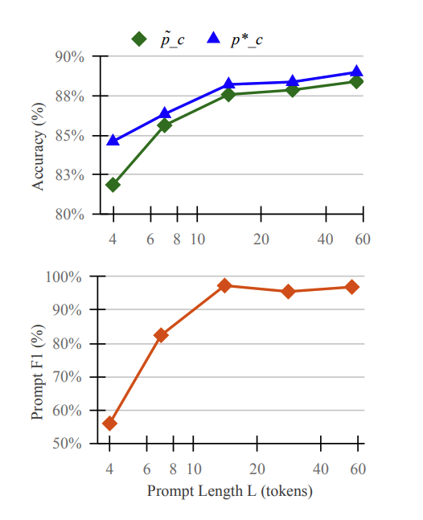
Experiment: effect of prompt length
The relative accuracy drop is marginal when the prompt length is not too small (e.g. 7 or larger).

